Slide 1
Distributed Computing Paradigm
Chapter 2

Slide 2
2.1 Paradigm and Abstraction
Paradigm:
Paradigm means “a pattern, example, or model.”
一种广义的模型、框架、思维方式;
Abstractions:
Abstraction is the idea of detail hiding.
In software engineering, abstraction is realized with the provision of tools or facilities which allow software to be built without the developer having to be cognizant of some of the underlying complexities.(工具和设施就是一种抽象实现，使开发人员可以简化开发)

Slide 3
2.1 Paradigm and Abstraction
Important characteristics that distinguish distributed applications from conventional applications which run on a single machine:
Interprocess communication: A distributed application requires the participation of two or more independent entities (processes). To do so, the processes must have the ability to exchange data among themselves.
Event synchronization: The sending and receiving of data among the participants of a distributed application must be synchronized.
Notes:
单机-进程同步：协作，互斥，共享内存通信
多机-进程同步：不同进程位于不同机器上，通过网络通信-communication，sending and receiving of data时通过事件同步

Slide 4
2.1 Overview of presented Paradigms
Message passing
Remote Procedure Call
Client-server
Peer-to-Peer
Message system:
Point-to-point;
Publish/Subscribe
Distributed objects:
Remote method invocation
Network services
Object Request Broker
Object space
Component Based Technologies
Mobile agents
Collaborative applications
Notes:
从什么角度划分？通信控制方式？

Slide 5
2.2 The Message Passing Paradigm
Message passing is the most fundamental paradigm for distributed applications.
A process sends a message representing a request.
The message is delivered to a receiver, which processes the request, and sends a message in response.
In turn, the reply may trigger a further request, which leads to a subsequent reply, and so forth.
进程A
进程B
Send M1 receive
Receive M2 Send
Send M3 receive

Slide 6
2.2 The Message Passing Paradigm
The basic operations: send, and receive.
For connection-oriented communication, the operations connect and disconnect are also required.
Event synchronization(synchronous/asynchronous)
With the abstraction provided by this model, the interconnected processes perform input and output to each other, in a manner similar to file I/O. The I/O operations encapsulate the detail of network communication at the operating-system level.
Notes:
根据网络是否是connection-oriented，Event synchronization分为同步和异步；
Event？
With the abstraction provided by this model？

Slide 7
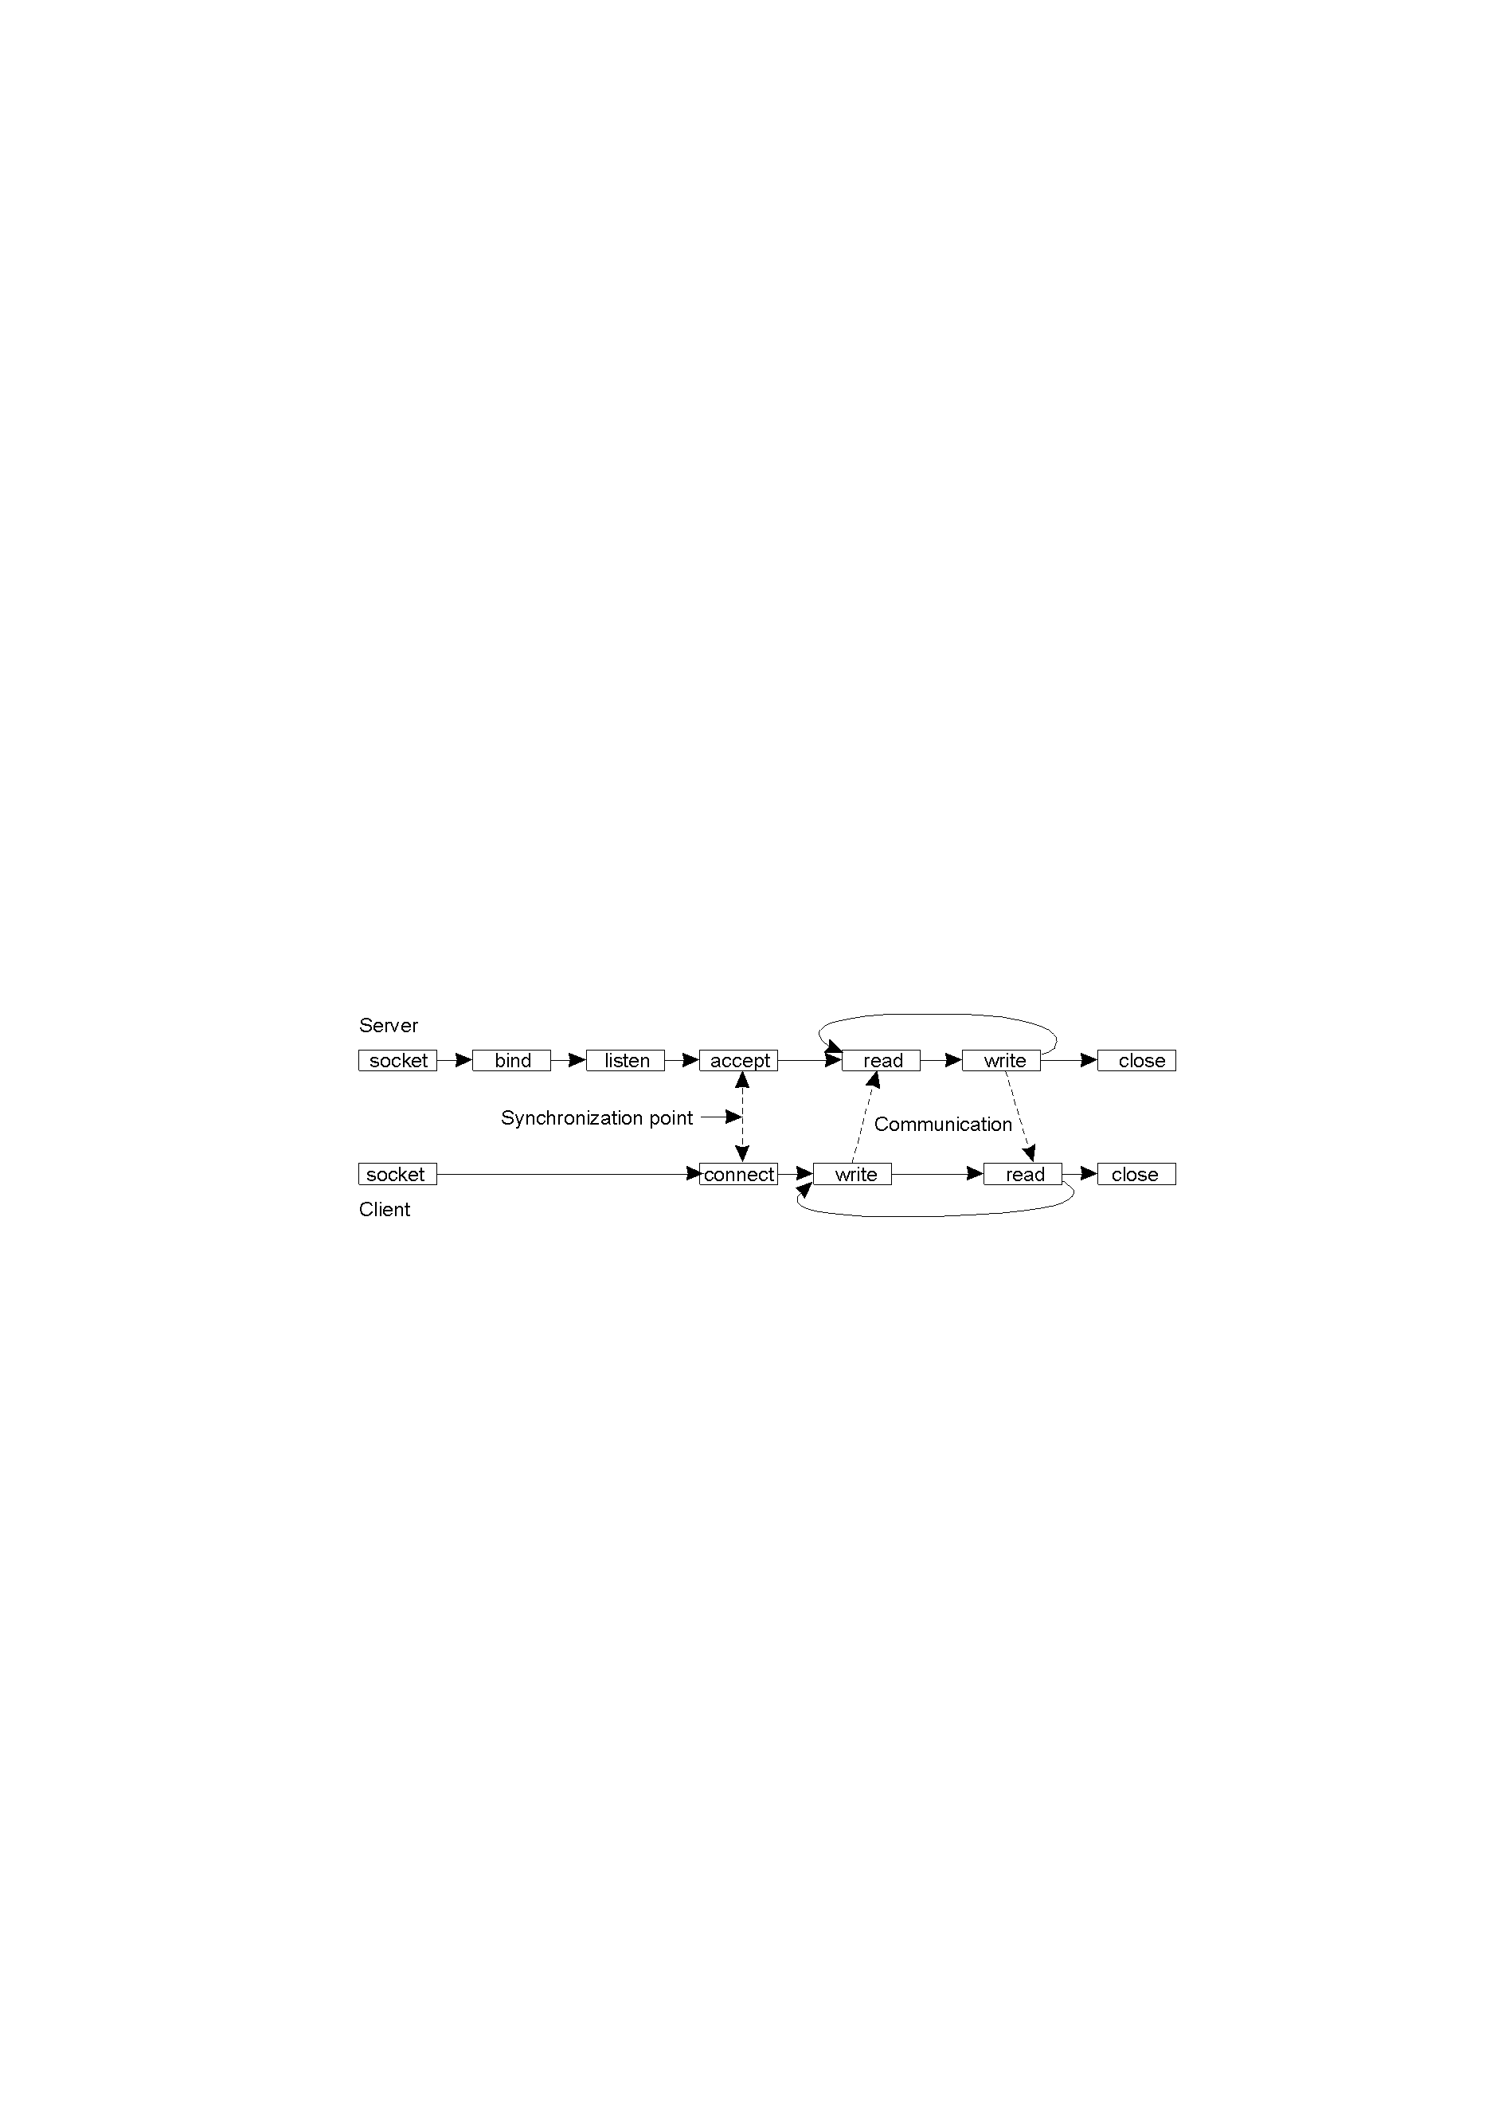
2.2 The Message Passing Paradigm
The socket application programming interface is based on this paradigm.
http://www.sockets.com/
hfdgdgttp://java.sun.com/products/jdk/1.2/docs/api/index.html
Connection-oriented communication pattern using sockets.
Notes:
socket如何使用？和bind, listen的关系？

Slide 8
2.3 Remote Procedure Call
Message passing
Remote Procedure Call
Client-server
Peer-to-Peer
Message system:
Point-to-point;
Publish/Subscribe
Distributed objects:
Remote method invocation
Network services
Object Request Broker
Object space
Component Based Technologies
Mobile agents
Collaborative applications

Slide 9
2.3 Remote Procedure Call
Interprocess communications proceed as procedure, or function, calls, which are familiar to application programmers.
Process A
Process B
Proc1(arg1,arg2)
返回值
A process, A, wishing to make a request to another process, B, issues a procedure call to B, passing with the call a list of argument values.
As in the case of local procedure calls, a remote procedure call triggers a predefined action in a procedure provided by process B.
At the completion of the procedure, process B returns a value to process A.
Notes:
Event synchronization？ 同步还是异步？

Slide 10
2.3 Remote Procedure Call
Since its introduction in the early 1980s, the RPC model has been widely in use in network applications. There are two prevalent APIs for Remote Procedure Calls.
The Open Network Computing Remote Procedure Call, evolved from the RPC API originated from Sun Microsystems in the early 1980s.
The Open Group Distributed Computing Environment (DCE) RPC.
Both APIs provide a tool, rpcgen,可以自动生成RPC服务器程序的大多数代码，包含实现客户机和服务器程序所需要的大部分源代码。
Notes:
two prevalent APIs？
rpcgen？RPC服务器程序的大多数代码？包含实现客户机和服务器程序所需要的大部分源代码？

Slide 11
2.3 Remote Procedure Call
一种拍卖系统的RPC实现：
拍卖者为竟拍者提供2个远程过程：
1.竟拍者注册过程；
2.竟拍者投标过程；
竟拍者为拍卖者提供3个远程过程：
1.允许拍卖者向竟拍者宣布拍卖开始;
2.允许拍卖者向竟拍者通告最新标价;
3.允许拍卖者向竟拍者宣布拍卖结束.
思考题：写出拍卖系统的程序框架

Slide 12
2.4 Client-Server Paradigm
Message passing
Remote Procedure Call
Client-server
Peer-to-Peer
Message system:
Point-to-point;
Publish/Subscribe
Distributed objects:
Remote method invocation
Network services
Object Request Broker
Object space
Component Based Technologies
Mobile agents
Collaborative applications

Slide 13
2.4 Client-Server Paradigm
Perhaps the best known paradigm for network applications, the client-server model, assigns asymmetric roles to two collaborating processes.
Notes:
service如何定义？

Slide 14
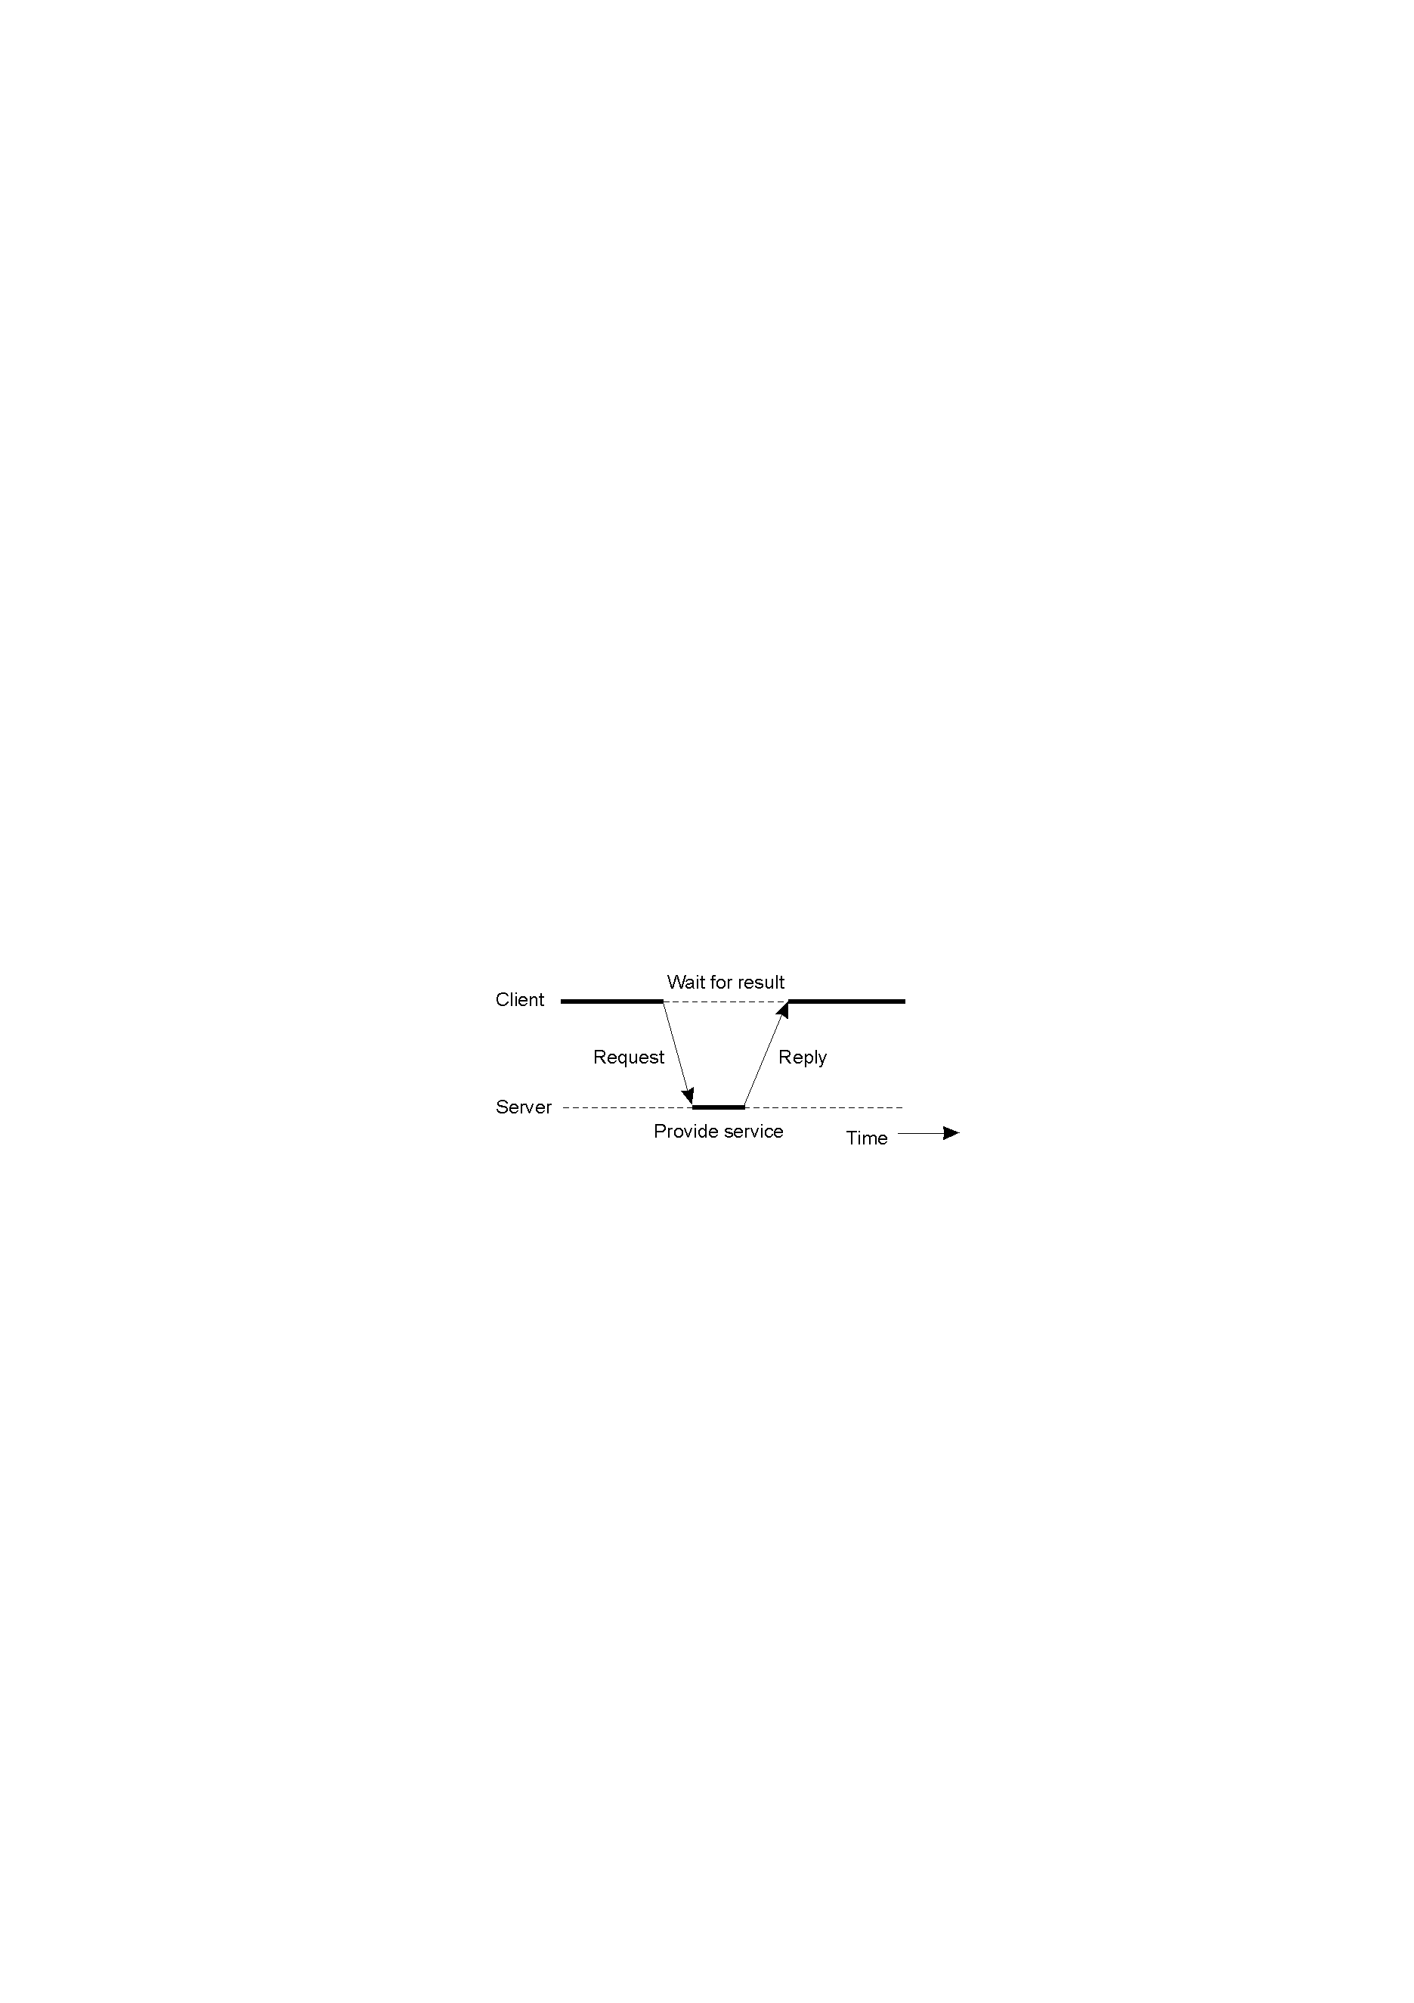
2.4 Client-Server Paradigm
Client和server分别扮演服务请求者和服务提供者
1.25
client – server paradigm.
Notes:
基于message-passing-可靠通信；
send-receive进行通信；
事件同步：同步
1.
the server process waits for requests（receive）, client send
2.
the client in turn waits for responses （receive）, server send

Slide 15
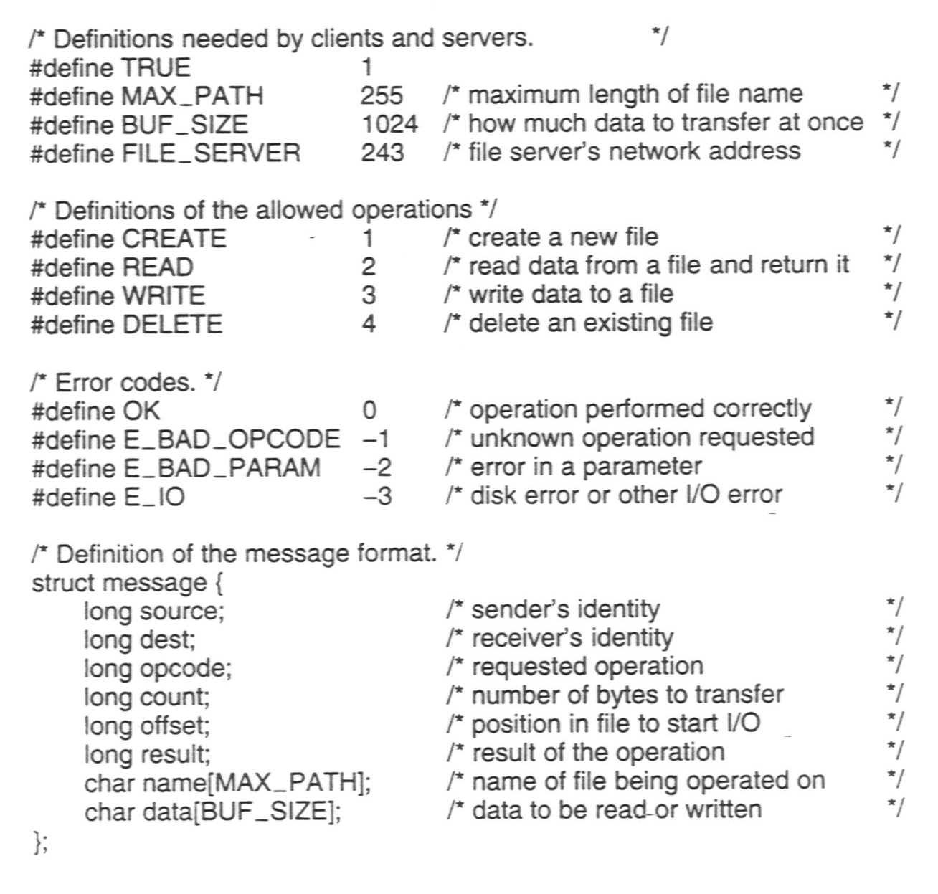
An Example Client and Server (1)
The header.h file used by the client and server.
Notes:
server端存有文件系统供client端访问：
header.h file，加载到client和server进程的源程序里使用；
参数，可调用的方法，包含对文件的四种操作；
错误处理；
传输消息格式；

Slide 16
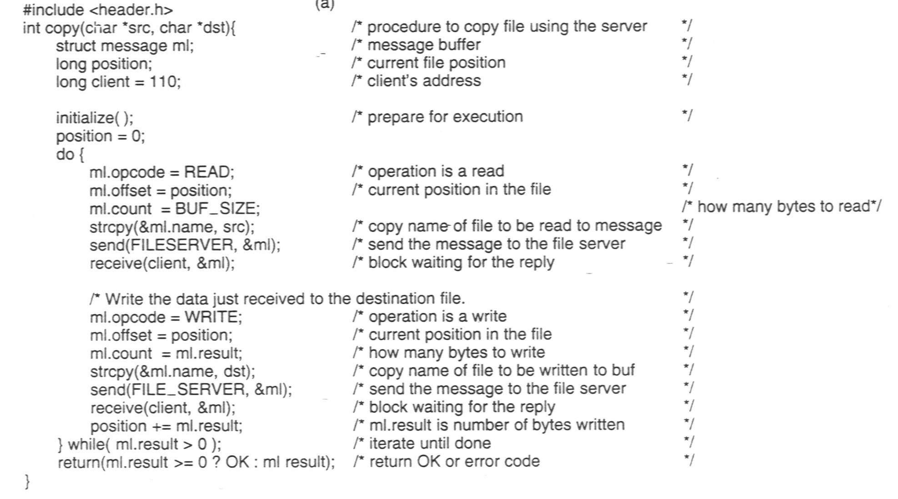
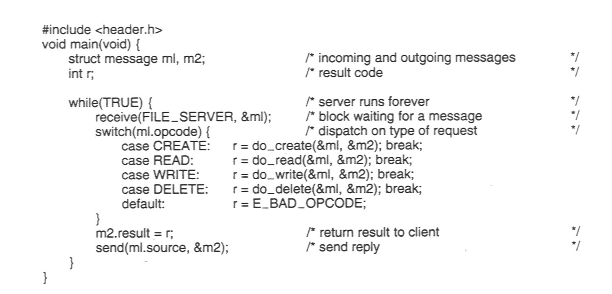
An Example Client and Server (2)
A sample server.
A client using the server to copy a file.
Notes:
send和receive如何定义？和message passing有何区别？
server：receive监听
client：文件操作类型放进ml里，send给server
server：根据ml里的操作类型进行文件操作

Slide 17
2.4 Client-Server Paradigm
The client-server model provides an efficient abstraction for the delivery of network services.
Operations required include those for a server process to listen and to accept requests, and for a client process to issue requests and accept responses.
By assigning asymmetric roles to the two sides, event synchronization is simplified: the server process waits for requests, and the client in turn waits for responses.
Many Internet services are client-server applications. Well known Internet services include HTTP, FTP, DNS, finger, gopher, etc.
Notes:
efficient abstraction for the delivery of network services？
具体是什么operation？
event synchronization如何理解？the server process waits for requests, and the client in turn waits for responses

Slide 18
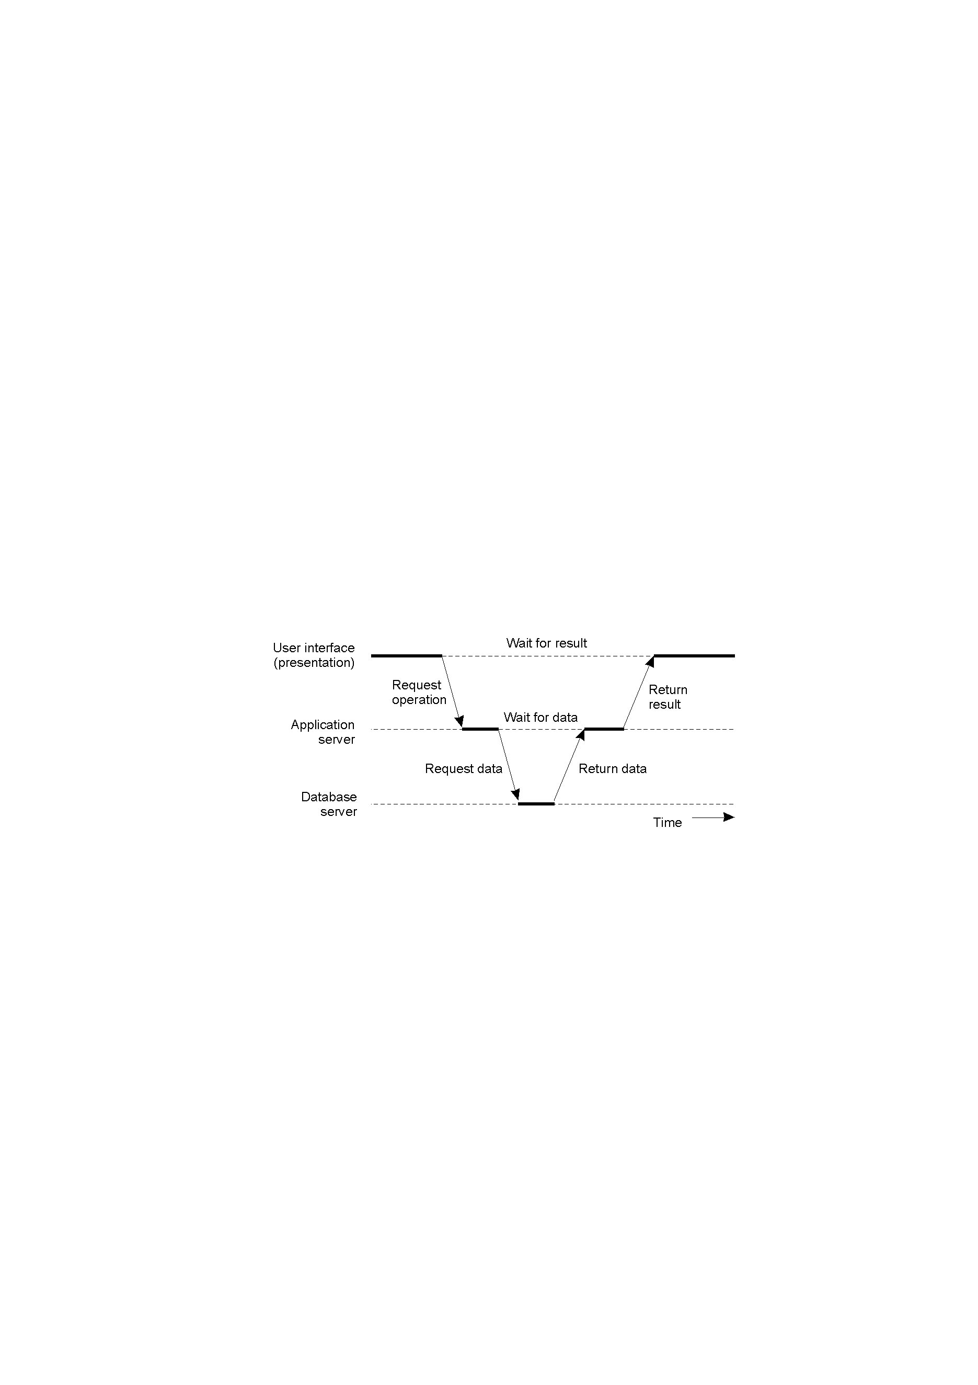
Multitiered Architectures
服务器有时会担任客户机的角色, 形成多层体系结构
1-30
An example of a server acting as a client.
Notes:
用户接口程序：为用户提供接口，使得用户可以和应用程序交互；
应用程序：三部分：和用户接口程序交互；应用核心逻辑；和数据库程序交互；
数据库程序：

Slide 19
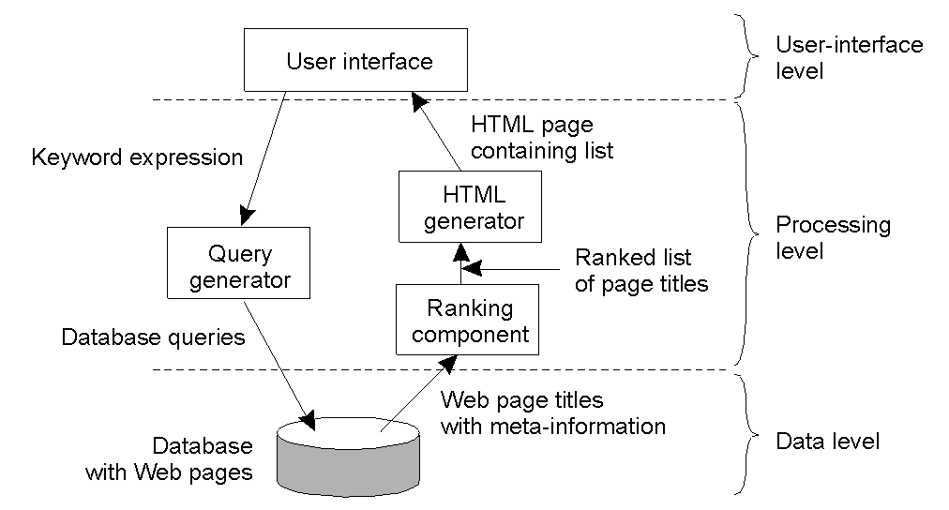
举例
1-28
The general organization of an Internet search engine into three different layers
Notes:
user interface：通过键盘敲入关键词，返回包含关键词的网页列表；
HTML页包含查询结果；

Slide 20
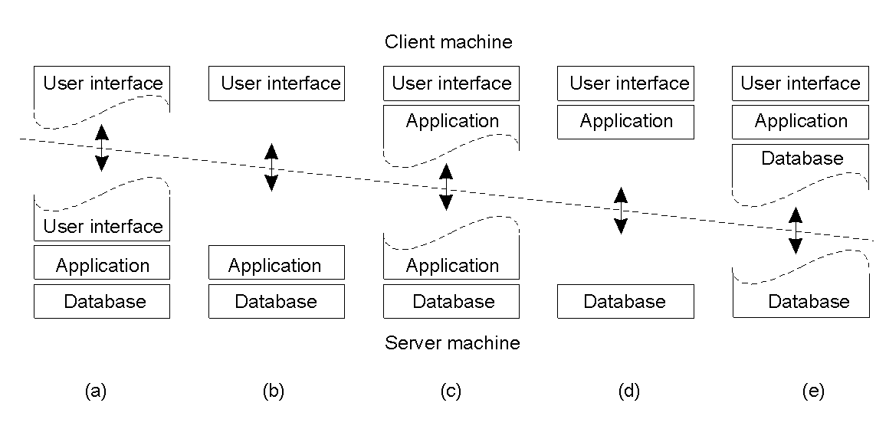
Multitiered Architectures
客户端与服务器端划分部署：
1-29
Alternative client-server organizations (a) – (e).
Notes:
左：紧耦合，用于专用场景；部分用户程序放到服务器端；
右：部分应用程序，部分数数据库程序放到server端，减少服务器开销

Slide 21
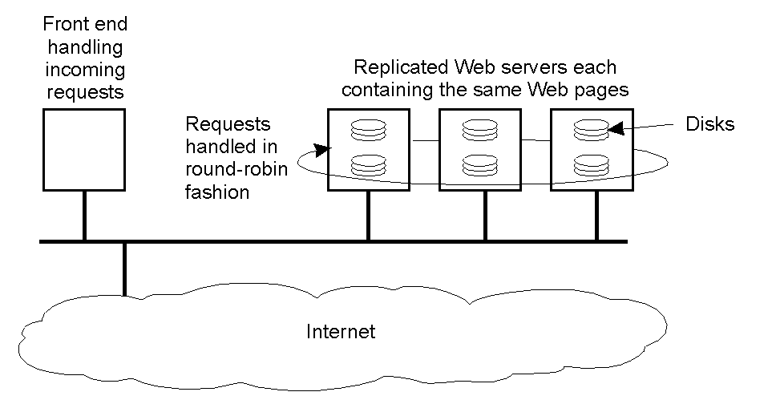
Modern Architectures 多层也可以按横向划分(horizontal distribution) 实现负载均衡
1-31
An example of horizontal distribution of a Web service.
Notes:
在服务器端或者client端横向扩展

Slide 22
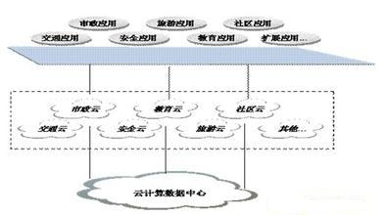
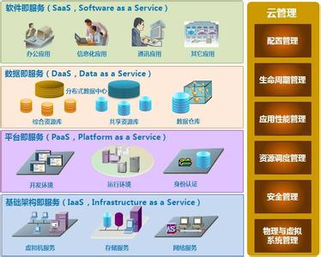
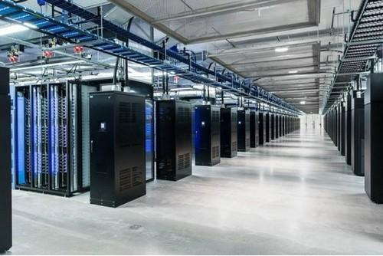
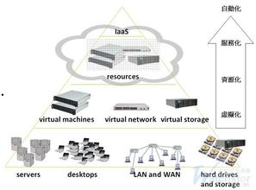
云计算——Client-Server的一种商业实现
Notes:
？？

Slide 23
2.5. Peer-to-Peer Paradigm
Message passing
Remote Procedure Call
Client-server
Peer-to-Peer
Message system:
Point-to-point;
Publish/Subscribe
Distributed objects:
Remote method invocation
Network services
Object Request Broker
Object space
Component Based Technologies
Mobile agents
Collaborative applications

Slide 24
2.5. Peer-to-Peer Paradigm
Peer-to-peer is an architecture where computer resources and services are direct exchanged between computer systems. These resources and services include the exchange of information, processing cycles, cache storage, and disk storage for files.
The participating processes play equal roles, with equivalent capabilities and responsibilities (hence the term “peer”, 角色平等)
Notes:
resources and services？
processing cycles？

Slide 25


2.5. Peer-to-Peer Paradigm
Napster.com是P2P的一个里程碑, 为用户提供了一个上传、检索和下载作品的平台，可以将在线用户的MP3音乐信息进行自动搜寻并分类整理。2001年被传媒巨头贝塔斯曼集团收购。
P2P: centralized directory
Bob
centralized
directory server
original “Napster” design
1) when peer connects, it informs central server:
IP address
contents
2) Alice queries for “Hey Jude”
3) Alice requests file from Bob
1
peers
1
1
3
2
1
Alice
Ref: Computer Networking, Jim F. Kurose and Keith W. Ross
Notes:
纳普斯特

Slide 26
P2P: problems with centralized directory
File transfer is decentralized, but locating contents is highly centralized.
Single point of failure
Performance bottleneck
Copyright infringement(版权问题)
一种完全分布式p2p协议Query flooding: Gnutella
设一个用户连接4台计算机，每台计算机又连接4 台计算机，用户能与其他(4 + 4 * 4 = )20个用户进行信息交流，消息沿着网络传递2次（ TTL为2）。假定TTL为3，则它能进行信息交流的计算机的总数4 + 4 * 4 + 4 * 4 * 4 = 84。节点数量与它搜寻请求的TTL值(Time-To-Live生存时间)和随TTL增长的节点数目成指数增加关系；
Notes:
Copyright infringement(版权问题)
努特拉

Slide 27
Gnutella: protocol
Query message sent over existing TCP connections
peers forward Query message
QueryHit sent over reverse path
File transfer:HTTP
Query
QueryHit
Query
Query
QueryHit
Query
QueryHit
Query
Ref: Computer Networking, Jim F. Kurose and Keith W. Ross

Slide 28
Query flooding: Gnutella
Overlay network: graph
edge between peer X and Y if there’s a TCP connection
all active peers and edges is overlay network
Edge is not a physical link
Given peer will typically be connected with < 10 overlay neighbors
fully distributed
—no central server
public domain protocol
many Gnutella clients implementing protocol
Ref: Computer Networking, Jim F. Kurose and Keith W. Ross
Notes:
public domain
覆盖网络？
Edge is not a physical link?

Slide 29
2.5. Peer-to-Peer Paradigm（其他应用）
流媒体超大规模应用: 包括流媒体编码发布、广播、播放和超大规模用户直播 。比如PPStream等；
即时通信软件: 比如ICQ、QQ、MSN等；
区块链:去中心化的分布式账本;
游戏软件: 目前的许多网络游戏都是通过对等网络方式实现的；
存储软件: 比如Farsite，用于在网络上将存储对象分散存储。
数据搜索及查询软件：比如Infrasearch、Pointera，用来在对等网络中完成信息检索；
协同计算软件：比如Netbatch，可连接几千或上万台PC，利用其空闲时间进行协同计算；
协同处理软件：比如Groove，可用于企业管理。

Slide 30
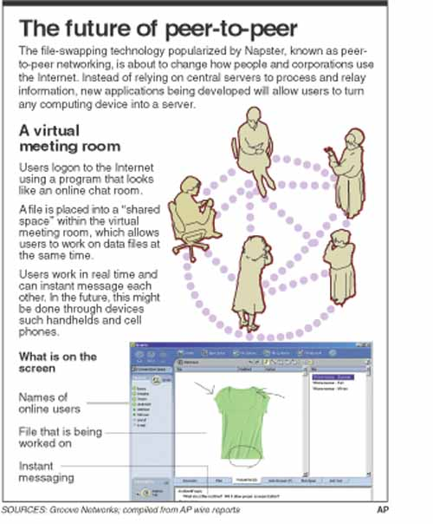
Notes:
？

Slide 31
2.5. Peer-to-Peer Paradigm
P2P的主要组织结构
(1)DHT结构
(2)树形结构
(3)网状结构
P2P计算尚无统一的标准。2000年8月成立了P2P工作组，成员包括Intel、IBM和HP公司等；
开源项目包括Project JXTA、Azureus、Shareaza等；
主要障碍有版权、监管、网络带宽、管理和安全问题等；
Notes:
DHT结构？

Slide 32
2.5. Peer-to-Peer 与client-server比较
The client-server paradigm is an ideal model for a centralized network service. 服务器集中，易出现性能瓶颈与单点失效；
The peer-to-peer paradigm is more appropriate for applications such as instant messaging, peer-to-peer file transfers, video conferencing, and collaborative work.
It is also possible for an application to be based on both the client-server model and the peer-to-peer model.
Notes:
服务器集中，易出现性能瓶颈与单点失效
安全性问题和版权问题
instant messaging？
video conferencing？

Slide 33
2.6. The Message System Paradigm
Message passing
Remote Procedure Call
Client-server
Peer-to-Peer
Message system:
Point-to-point;
Publish/Subscribe
Distributed objects:
Remote method invocation
Network services
Object Request Broker
Object space
Component Based Technologies
Mobile agents
Collaborative applications

Slide 34
2.6. The Message System Paradigm
A message system serves as an intermediary among separate, independent processes. It acts as a switch for messages, through which processes exchange messages asynchronously, in a decoupled manner；过程如下：
receiver
sender
消息队列
…
Message System
消息队列
…
Message
可以通过一个Message－Oriented Middleware实现消息的异步交换。
两种类型：（1）Point-to-point message model;
（2）Publish/Subscribe message model;
Notes:
Message－Oriented Middleware
abstraction如何定义？
和message passing的区别：asynchronously, in a decoupled manner；
事件同步；

Slide 35
1.The Point-To-Point Message Model
Asynchronous operations.
A message system forwards a message from the sender to the receiver’s message queue.
The middleware provides a message depository, and allows the sending and the receiving to be decoupled.
Via the middleware, a sender deposits a message in the message queue of the receiving process.
A receiving process extracts the messages from its message queue, and handles each one accordingly.
Notes:
message queue
message depository？
点对点发送：send和receive

Slide 36
2.The Publish/Subscribe Message Model
The publish/subscribe message model offers a powerful abstraction for multicasting or group communication.
The publish operation allows a process to multicast to a group of processes,
and the subscribe operation allows a process to listen for such multicast.
Notes:
一对多发送：publish和subscribe

Slide 37
2.The Publish/Subscribe Message Model
Each message is then associated with a specific topic or event.
Applications interested in the occurrence of a specific event may subscribe to messages for that event（订阅感兴趣事件消息）.
When the awaited event occurs, the process publishes a message announcing the event or topic（事件发生时发布消息）.
The middleware message system distributes the message to all its subscribers. （系统将消息送给订阅者）

Slide 38
2.6. The Message System Paradigm
举例：采用发布/订阅模型的拍卖系统
竟拍者
每个竟拍者都订阅一条“begin-auction”事件消息.
竟拍者在收到“begin-auction”事件消息后，订阅“end-auction”与“new-bid”事件消息；
收到“new-bid”事件消息；要出价的竟拍者发布一条“new-bid”事件，否则等待结束；
竟拍者在收到“end-auction”事件消息，拍卖结束；
拍卖者
拍卖者发布一条“begin-auction”事件消息，意味着拍卖会开始;
拍卖者订阅“new-bid”事件消息；
拍卖者收到“new-bid”事件消息，
发布“new-bid”事件消息；重复；
拍卖会结束时，拍卖者发布一条“end-auction”事件消息，
Notes:
双方都收到new-bid？

Slide 39
Toolkits based on the Message-System Paradigm
The MOM(Message Oriented Middleware). The IBM MQ*Series is an example of such a facility. Message Queue Services (MQS) have been in use since the 1980’s. http://www-4.ibm.com/software/ts/mqseries/
Other existing support for this paradigm:
Microsoft’s Message Queue (MSQ),
http://msdn.microsoft.com/library/psdk/msmq/msmq_overview_4ilh.htm
Java’s Message Service(JMS)
DDS（Data Distribution Service），数据分发服务中间件
Notes:
Java’s Message Service(JMS)

Slide 40
2.7 Distributed objects Paradigms
Message passing
Remote Procedure Call
Client-server
Peer-to-Peer
Message system:
Point-to-point;
Publish/Subscribe
Distributed objects:
Remote method invocation
Network services
Object Request Broker
Object space
Component Based Technology
Mobile agents
Collaborative applications

Slide 41
2.7 Distributed objects Paradigms
Distributed object is a natural extension of object-oriented software development.
Applications access objects distributed over a network. Objects provide methods, through the invocation of which an application obtains access to services.
Object-oriented paradigms include:
Remote method invocation (RMI)
Network services
Object Request Broker
Object spaces
Component-based Technology
Notes:
如何抽象？
把服务抽象为对象？

Slide 42
1. Remote Method Invocation (RMI)
A process invokes the methods in an object, which may reside in a remote host. As with RPC, arguments may be passed with the invocation.
Notes:
和RPC的区别

Slide 43
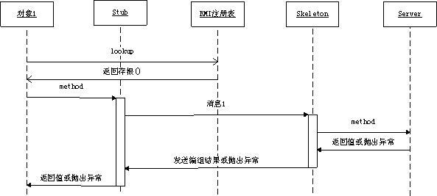
例. JAVA RMI
允许运行在一个java 虚拟机的对象调用运行在另一个java虚拟机上对象的方法。两个虚拟机可以在同一个计算机上，也可以不同计算机中。
Notes:
stub？skeletion？
RMI注册表？
两个角色
操作：调用方法，得到返回结果

Slide 44
2. The Network Services Paradigm
Service providers register themselves with directory servers on a network. A process desiring a particular service contacts the directory server at run time, and, if the service is available, will be provided a reference to the service. Using the reference, the process interacts with the service.
This paradigm is essentially an extension of the remote method call paradigm. The difference is that service objects are registered with a global directory service, allowing them to be look up and accessed by service requestors on a federated network（3个角色,实现了服务动态性,独立于语言）
Notes:
at run time？
3个角色,实现了服务动态性,独立于语言？
操作：公布、查找、绑定

Slide 45
2. The Network Services Paradigm - 2
Web-services extend the network of a message network service to the complete internet.
With web-services processes can communicate over HTTP.
Data is transferred using XML-based SOAP (Simple Object Access Protocol).
Notes:
和client-server泛型的区别？
Simple Object Access Protocol？

Slide 46
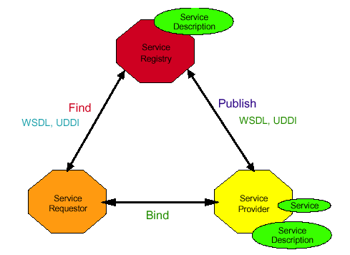
Web service
Web service曾被认为是下一代分布式系统开发的模型，可用于建立一种基于Web的、松散耦合的分布式计算平台。
Web service有三个部分组成：传输、描述和发现。
传输模块是在线交换的标准；
描述模块用于描述服务个体或服务的收集；
发现模块用于服务的发现。
Web 服务模型
三个基本角色：服务提供者、服务注册中心、服务请求者。
三个基本操作：公布、查找、绑定。
Notes:
service requestor: client?
service provider: server?

Slide 47

Web service与其他紧耦合模式的结合
可使系统的适应性更好
内聚化应用
CORBA
内聚化应用
SOAP
SOAP
RMI
CORBA
RMI
DCOM
Internet
DCOM
intranet
intranet
内聚化应用
数据孤岛
CORBA
SOAP
RMI
DCOM
intranet
Java’s Jini technology is also based on this paradigm.
Notes:
？内联网

Slide 48
3. The Object Request Broker Paradigm
ORB 基本架构
An application issues requests to an ORB, which directs the request to an appropriate object that provides the desired service.
The difference is that the ORB in this paradigm functions as a middleware which allows an application, as an object requestor, to potentially access multiple remote/ local objects.
The request broker may also function as an mediator for heterogeneous objects(异构对象中介), allowing interactions among objects implemented using different APIs and /or running on different platforms.与RMI的区别?
Notes:
object？
与RMI的区别？

Slide 49
3. The Object Request Broker Paradigm
This paradigm is the basis of the Object Management Group’s CORBA (Common Object Request Broker Architecture) architecture. （http://www.corba.org/）
CORBA是基于ORB结构的分布对象范型
Notes:
应用对象？领域设施？公用设施？

Slide 50
3. The Object Request Broker Paradigm
Tool kits based on the architecture include:
Inprise’s Visibroker http://www.inprise.com/visibroker/
Java’s Interface Development Language (Java IDL)
http://java.sun.com/products/jdk/idl/
Orbix’s IONA, and TAO from the Object Computing, Inc.
http://www.corba.org/vendors/pages/iona.html
Notes:
IDL？

Slide 51
4. The Object Space Paradigm
Perhaps the most abstract of the object-oriented paradigms, the object space paradigm assumes the existence of logical entities known as object spaces.
The participants of an application converge(会聚) in a common object space. A provider places objects as entries into an object space, and requesters who subscribe to the space access the entries.
Notes:
logical entities？

Slide 52
4. The Object Space Paradigm - 2
The object space paradigm provides a virtual space or meeting room among providers and requesters of network resources or objects.
This abstraction hides the detail involved in resource or object lookup needed in paradigms such as remote method invocation, object request broker, or network services.
Current facilities based on this paradigm include JavaSpaces.(http://java.sun.com/products/javaspaces/)
Notes:
hide resource？object lookup？（remote method invocation, object request broker, or network services）

Slide 53
5. Component-based Technologies
Component-based technologies such as Java Bean, and Enterprise Java Bean，COM/DCOM/.Net, CORBA are also based on distributed-object paradigms, as components are essentially specialized, packaged objects designed to interact with each other through standardized interfaces.
In addition, application servers, popular for enterprise applications, are middleware facilities which provide access to objects or components.
WebSphere from IBM
WebLogic Portal from BEA Systems
JEE from Sun Microsystems
Notes:
as components are essentially specialized, packaged objects designed to interact with each other through standardized interfaces？
middleware facilities？

Slide 54
2.8 The Mobile Agent Paradigm
Message passing
Remote Procedure Call
Client-server
Peer-to-Peer
Message system:
Point-to-point;
Publish/Subscribe
Distributed objects:
Remote method invocation
Network services
Object Request Broker
Object space
Component Based Technologies
Mobile agents
Collaborative applications

Slide 55
2.8 The Mobile Agent Paradigm
软件Agent技术最早可追溯到人工智能研究的初期阶段，1977年Hewitt提出了具有自组织性、反应机制和同步执行能力的软件模型，即最初的软件Agent思想。
90年代初General Magic公司提出了移动Agent概念: 即一个能在异构网络环境中自主地从一台主机迁移到另一台主机，并可与其它Agent或资源交互的软件实体。可以看成是软件Agent与分布式计算相结合的产物，具有软件Agent的基本特性--自治性、响应性、主动性和推理性外，还具有移动性。

Slide 56
2.8 The Mobile Agent Paradigm
A mobile agent is a transportable program or object(移动性).
An agent is launched from an originating host. the agent travels from host to host according to an itinerary that it carries.
At each stop, the agent accesses the necessary resources or services, and performs the necessary tasks to accomplish its mission.

Slide 57
2.8 The Mobile Agent Paradigm
The paradigm offers the abstraction for a transportable program or object.
In lieu of(代替) message exchanges, data is carried by the program/object as the program is transported among the participants.
Commercial packages which support the mobile agent paradigm include:
IBM’s Aglet system.
http://www.trl.ibm.co.jp/aglets/
Mitsubishi Electric ITA’s Concordia system
http://www.meitca.com/HSL/Projects/Concordia/Welcome.html 问题？

Slide 58
2.9 The Collaborative Application (Groupware) Paradigm
Message passing
Remote Procedure Call
Client-server
Peer-to-Peer
Message system:
Point-to-point;
Publish/Subscribe
Distributed objects:
Remote method invocation
Network services
Object Request Broker
Object space
Component Based Technologies
Mobile agents
Collaborative applications

Slide 59
2.9 The Collaborative Application (Groupware) Paradigm
In this model, processes participate in a collaborative session as a group.
Each participating process may contribute input to part or all of the group.
Processes may do so using:
multicasting to send data to all or part of the group, or they may use
virtual sketchpads(画板) or whiteboards which allows each participant to read and write data to a shared display.

Slide 60
计算范型小结：
基本范型
混合范型
商业实现
网格
物联网
云计算
边缘计算
区块链
消息中间件
虚拟化
……

Slide 61
Choosing a paradigm
To varying degrees, paradigms provide abstractions that insulate the developers from the detail of interprocess communication and event synchronization, allowing the programmer to concentrate on the bigger picture of the application itself.(关注应用逻辑本身)
In choosing a paradigm or a tool for an application, there are tradeoffs that should be considered, including overheads, scalability, cross-platform support, and software engineering issues etc.

Slide 62
2.10 Architectural Styles (1)
描述分布式系统组成的逻辑结构（软件组件角度），包括：组件、组件之间的相互链接方式、组件之间的数据交换，以及如何集成。
Important styles of architecture for distributed systems
Layered architectures
Object-based architectures
Data-centered architectures
Event-based architectures

Slide 63
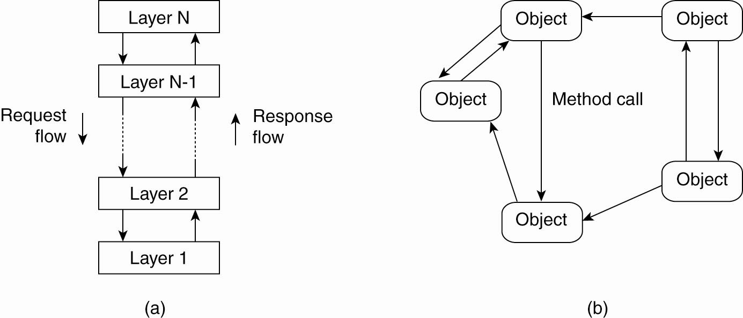
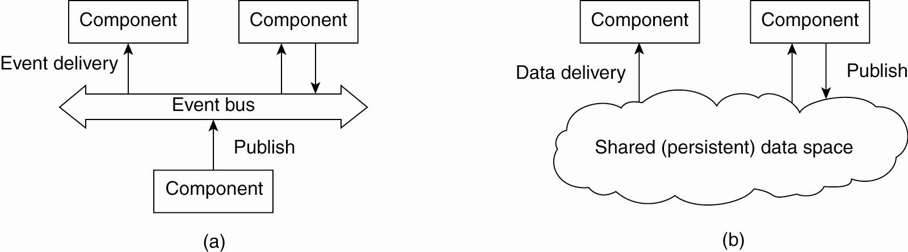
Architectural Styles (2)
The layered architectural style
The object-based architectural style.
(c)
(d)
The event-based architectural style
The shared data-space architectural style.

